Slide 1

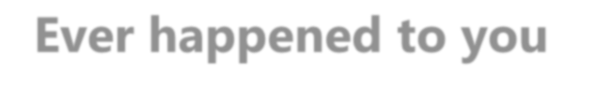


Ever happened to you ?
2
Delayed flight ?

Slide 2
Introduction
Introduction
In 2015 there were lots of flight delays in the United States. The U.S. Department of Transportation’s (DOT) Bureau of Transportation Statistics tracks the status of the flights by providing a summary of the arrival delays, departure delays, scheduled departure, on-time arrival in their monthly report. The data is acquired from Kaggle:https://www.kaggle.com/usdot/flight-delays. The flight data set contains 5819079 rows with 31 columns and 14 different carriers.

Slide 3
Gathering Data
For this project, I developed a model to predict how long a flight will be delayed at the Destination Airport. I created a Data set that can be used for both visualization and Model Building. The purpose of the visualization is to get a better inference of the data.
For the Split test, I have separated the Dataset into training and Testing Data so that prediction can be done on the testing Data. I also import Tableau that can make the visualization more feasible.
The technical aspect used is visualization: matplolib, seaborn. Including data manipulation: pandas, NumPy, modeling -sklearn: Linear Regression, Random Forest & Decision tree.

Slide 4
Data Set
The data is acquired from Kaggle:https://www.kaggle.com/usdot/flight-delays. It is contains 3 csv files: Flight Delays, Airlines and Airports.
The flight data set contains 5819079 rows with 31 columns and 14 different carriers.

Slide 5
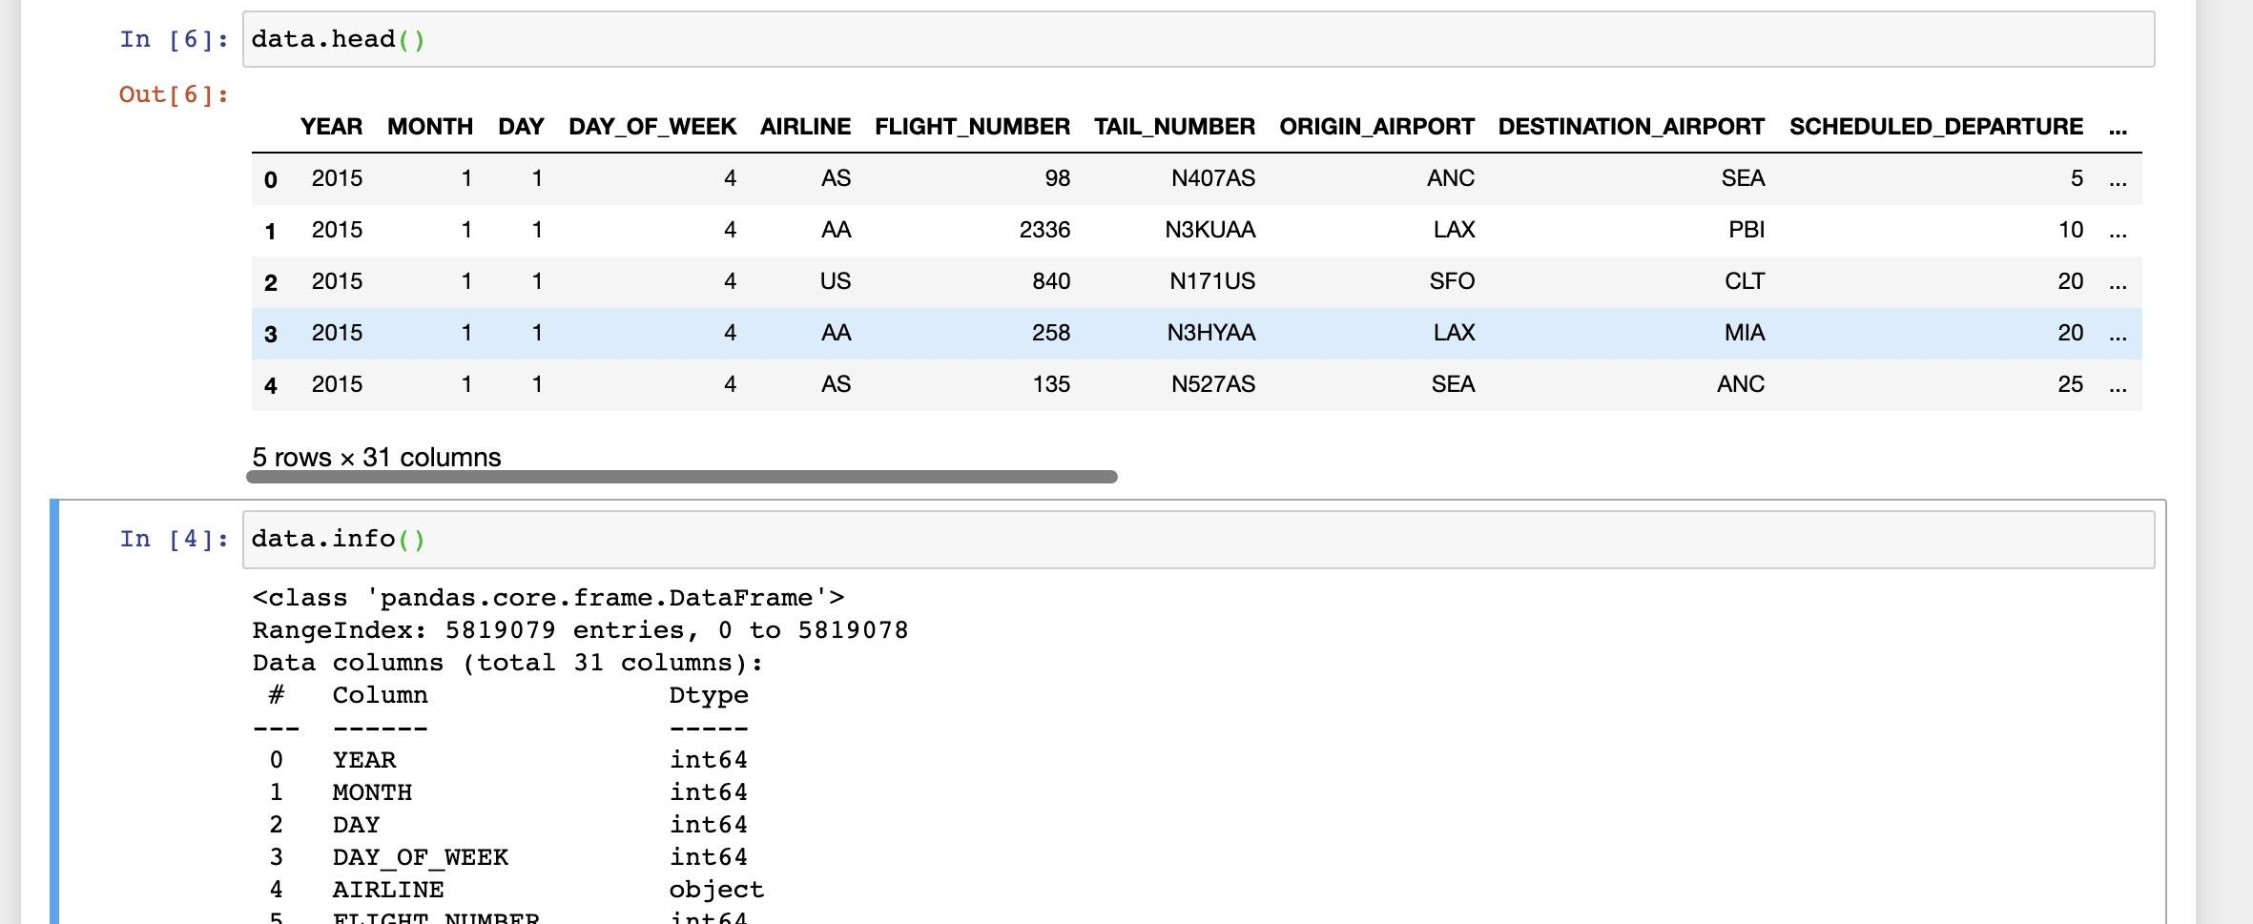
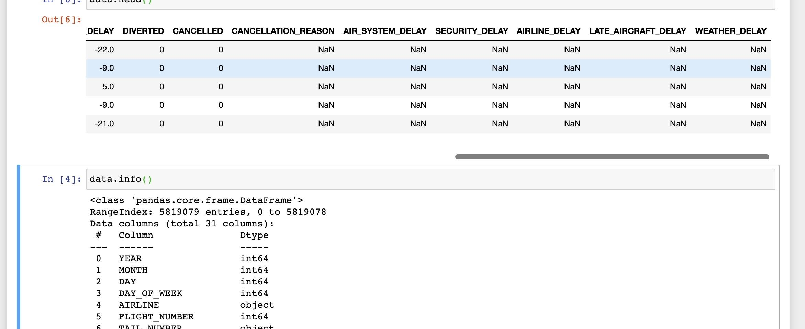
Data Set
From the above table, it is clear that the data is not properly organized. The data has many unnecessary columns that are not useful for visualization .

Slide 6
Approah
Tools/Techniques
Steps
7
Define Problem Statement
Data Collection
Process Data Analysis/ Cleaning
Explore the Data
Perform In depth Analysis
Data Modelling/Building
Linear Regression, Random Forest, Decision Tree Regressor
Model Evaluation

Slide 7
Data preprocessing
8
Missing Values:
The data files contain many columns with Missing Values(NAN): Cancellation_Reason, Air_System_Delay, Security_Delay, Airline_Delay, Late_Aircraft_Delay, Weather_Delay.
I replaced the NAN values with 0.

Slide 8
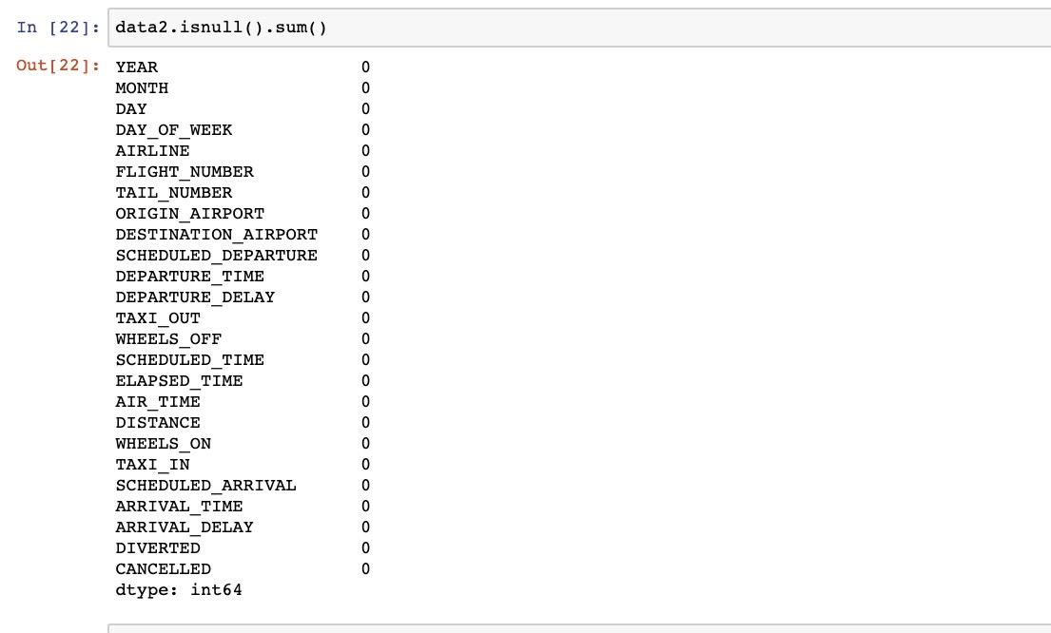
Data Processing

Slide 9
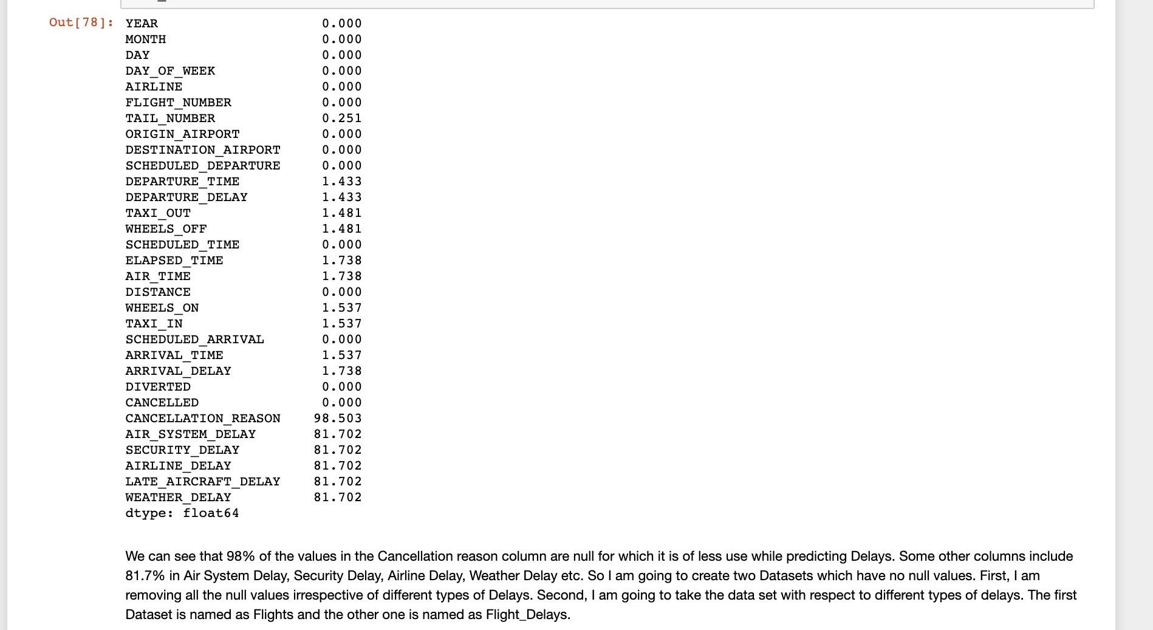
# Creating Dataset by removing null

Slide 10
Merging Data
Since there are three dataset it is required to merge all the three data set so that we can use them during the visualization in a proper way.

Slide 11
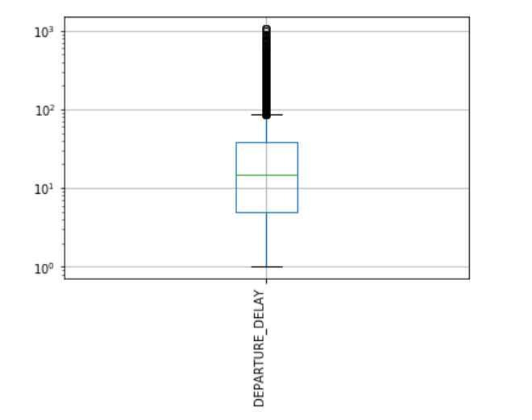

Slide 12
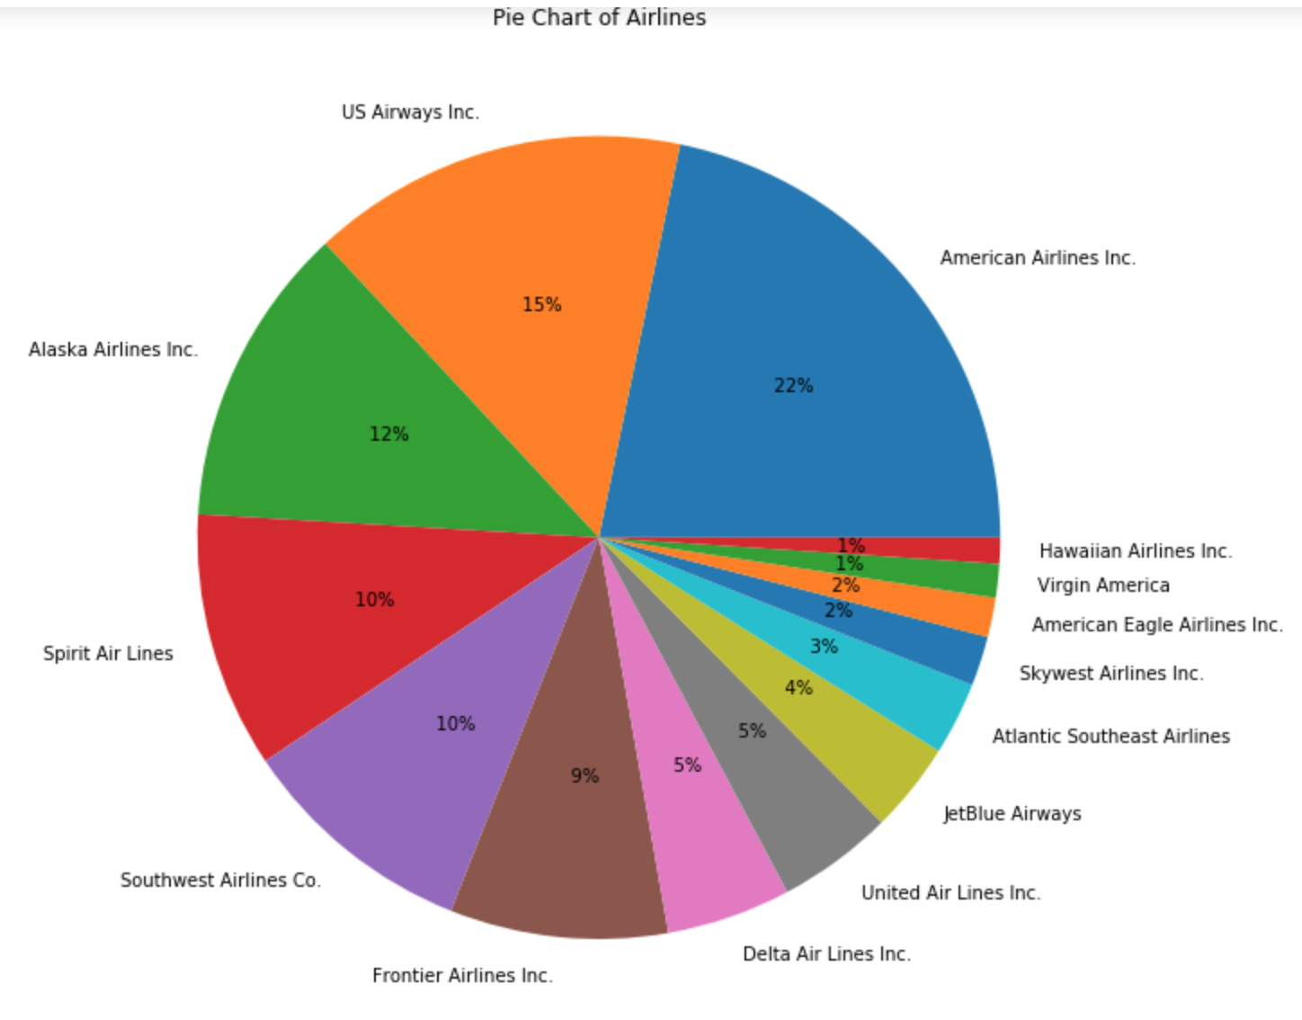
MARKET SHARES OF AIRLINE COMPANIES
Let’s first take a look at the market shares of airlines to have a general understanding of flight volumes for each airline company.
American Airlines 22%

Slide 13
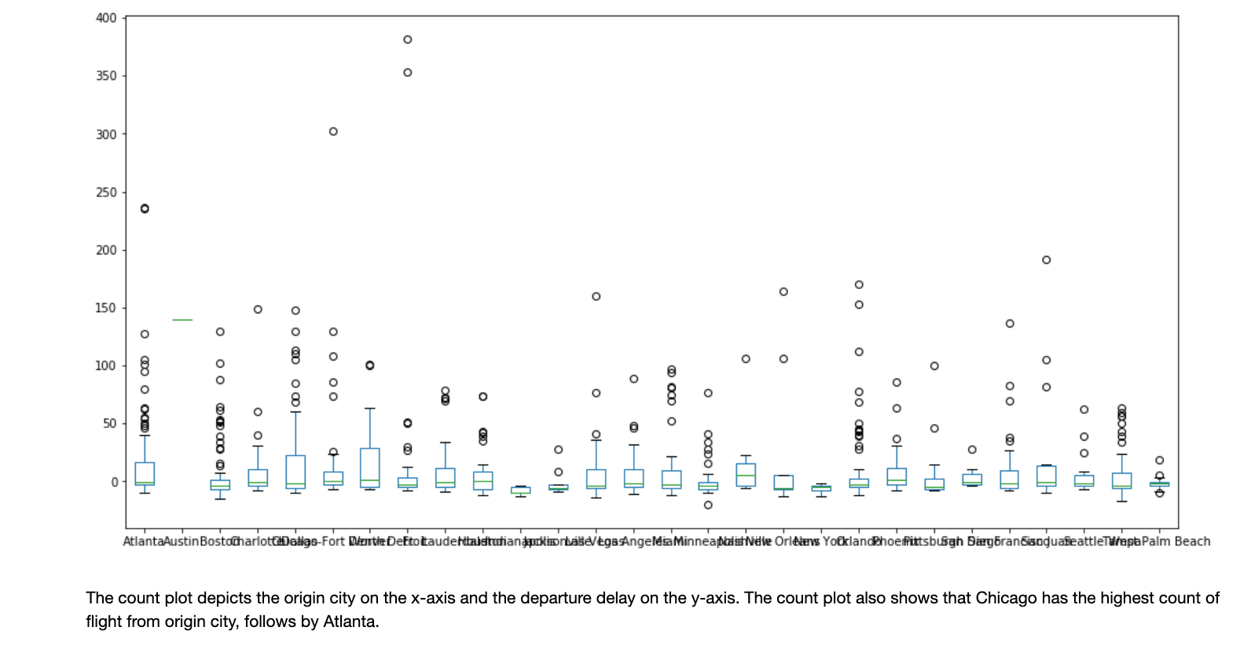
Notes:
These are box plots which show a standardized way of displaying the distribution of data.
It also gives us a summary about outliers in the data. The round points/bubbles are outliers.

Slide 14
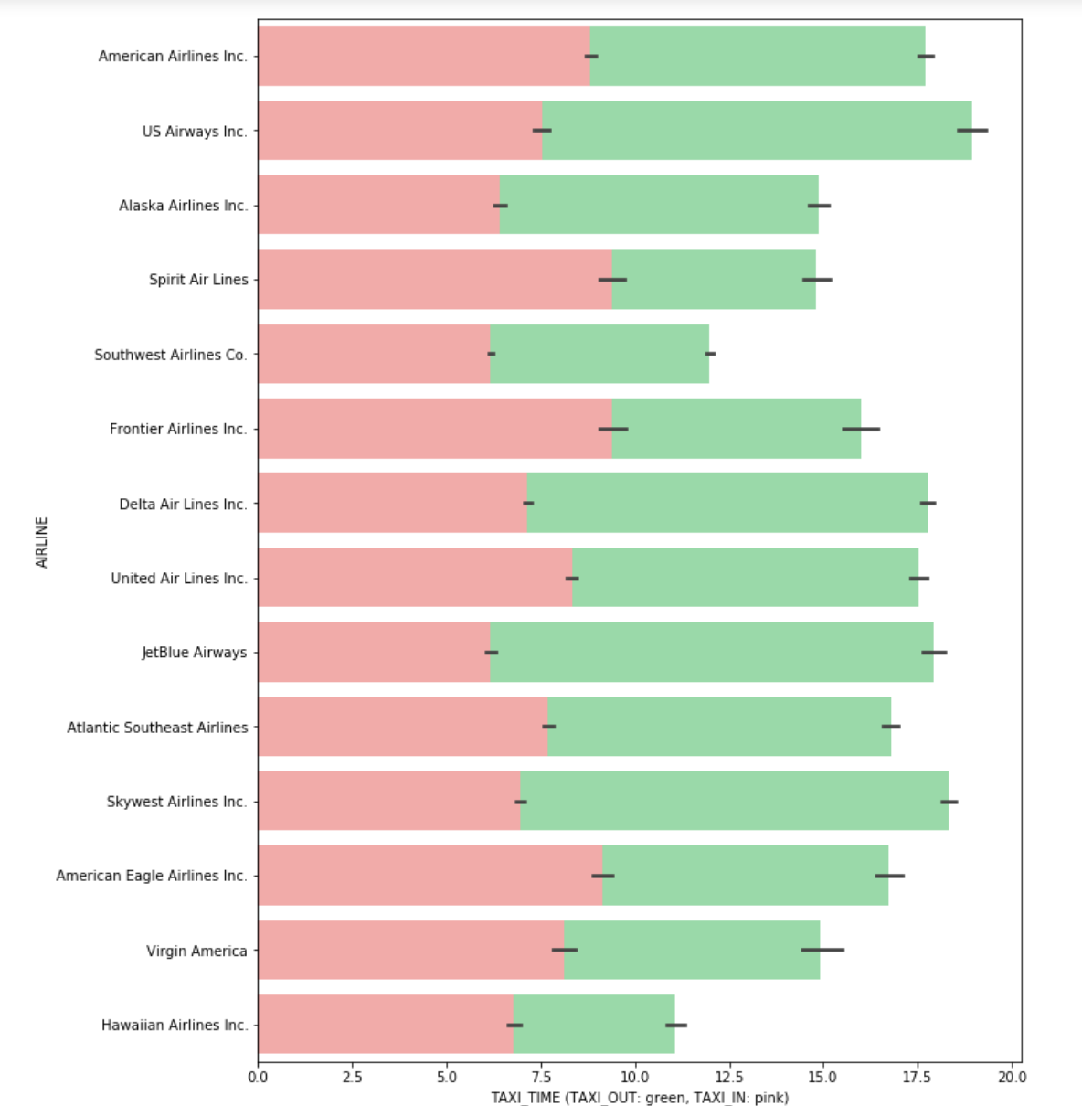

Slide 15
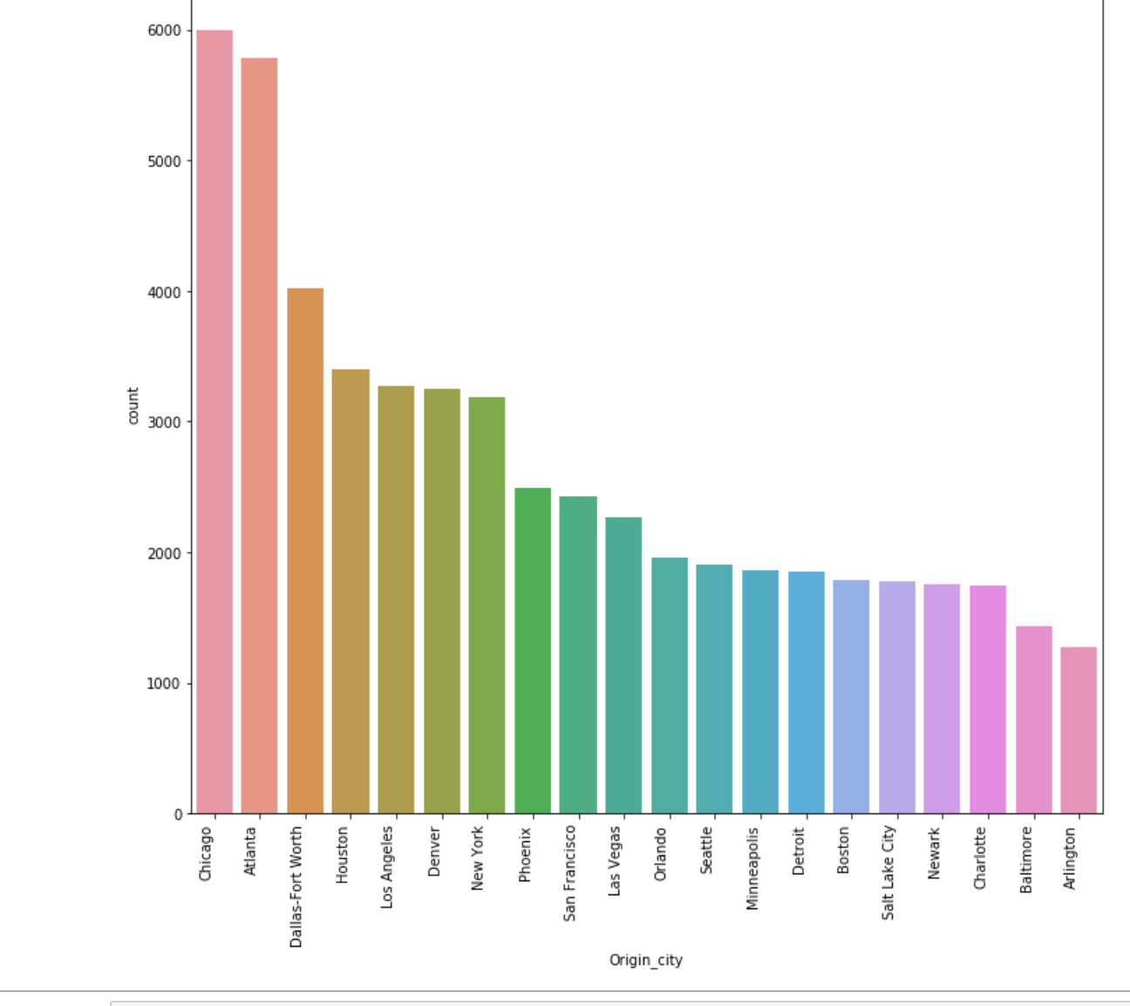
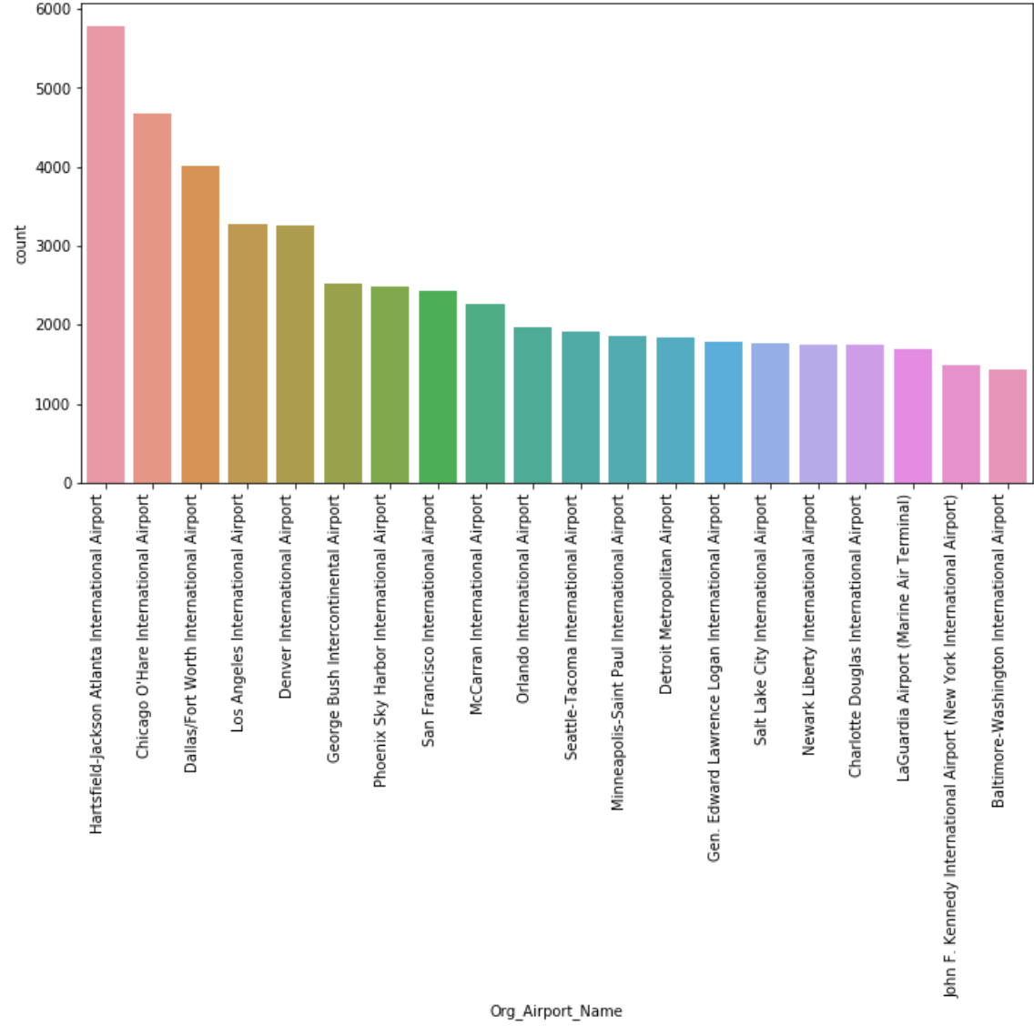
Data Exploration
10
Interpreting flights delayed
by Origin_City
Interpreting flights delayed by Origin_Airport_name
t
It is seen that more delays are observed from Hartsfield–Jackson Atlanta International Airport. And less delay from Baltimore washington international airport
It seems that Chicago has the delays by Origin_City. Arlington airport has the least delays.
Notes:
These two plot shows the delay counts by city and airport. It shows that Chicago city has the most delayed flights and Hartsfield–Jackson Atlanta International Airport is tha aiport that had most flights delayed.

Slide 16
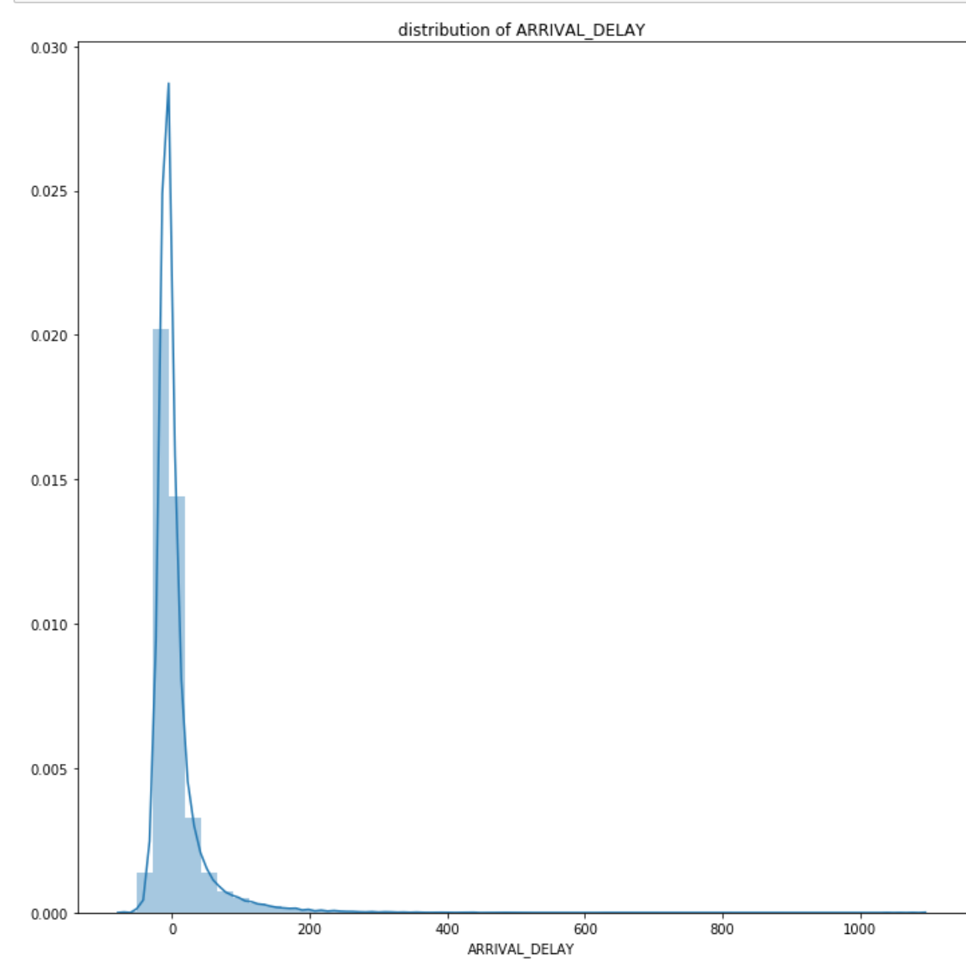
Notes:
The graph above is about density and histogram of Arrival_Delays. The dependent variable is right skewed/positively skewed. It means that it has a lot of positive delays instead of negative delays/no delays.

Slide 17
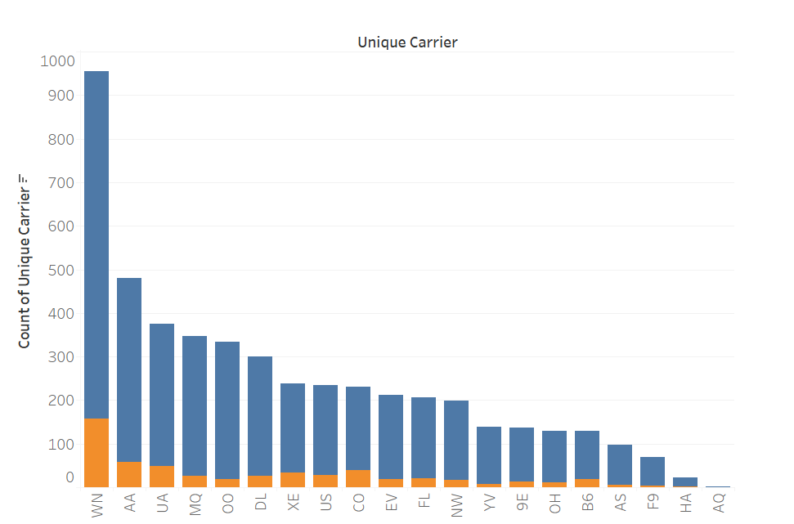

Data Exploration(contd..)
12
This bar chart show how many flights are delayed per carrier.
Notes:
This plot shows, higher the number of flights, higher the number of delays. It also shows that delays don’t depend on the type of carrier as you can see the percentage of delays is almost the same for each carrier.

Slide 18
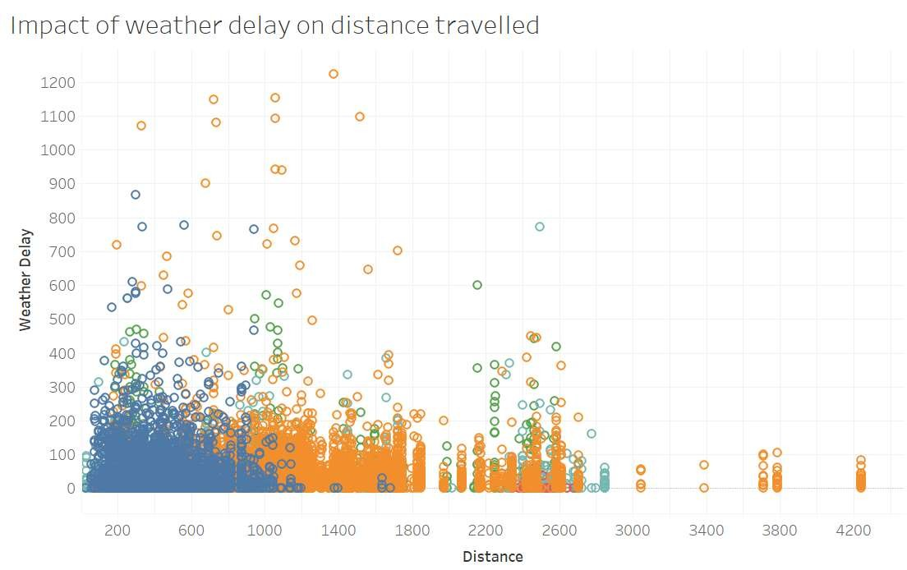
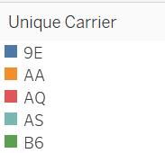
Data exploration(contd..)
11
Long distance flights seem to be less affected by weather delay.
Notes:
In this graph, you can see that Long distance flights seem to be less affected by weather delay. And the weather delays mostly affect the short distance flights which otherwise would have reached on time if not for the bad weather.

Slide 19
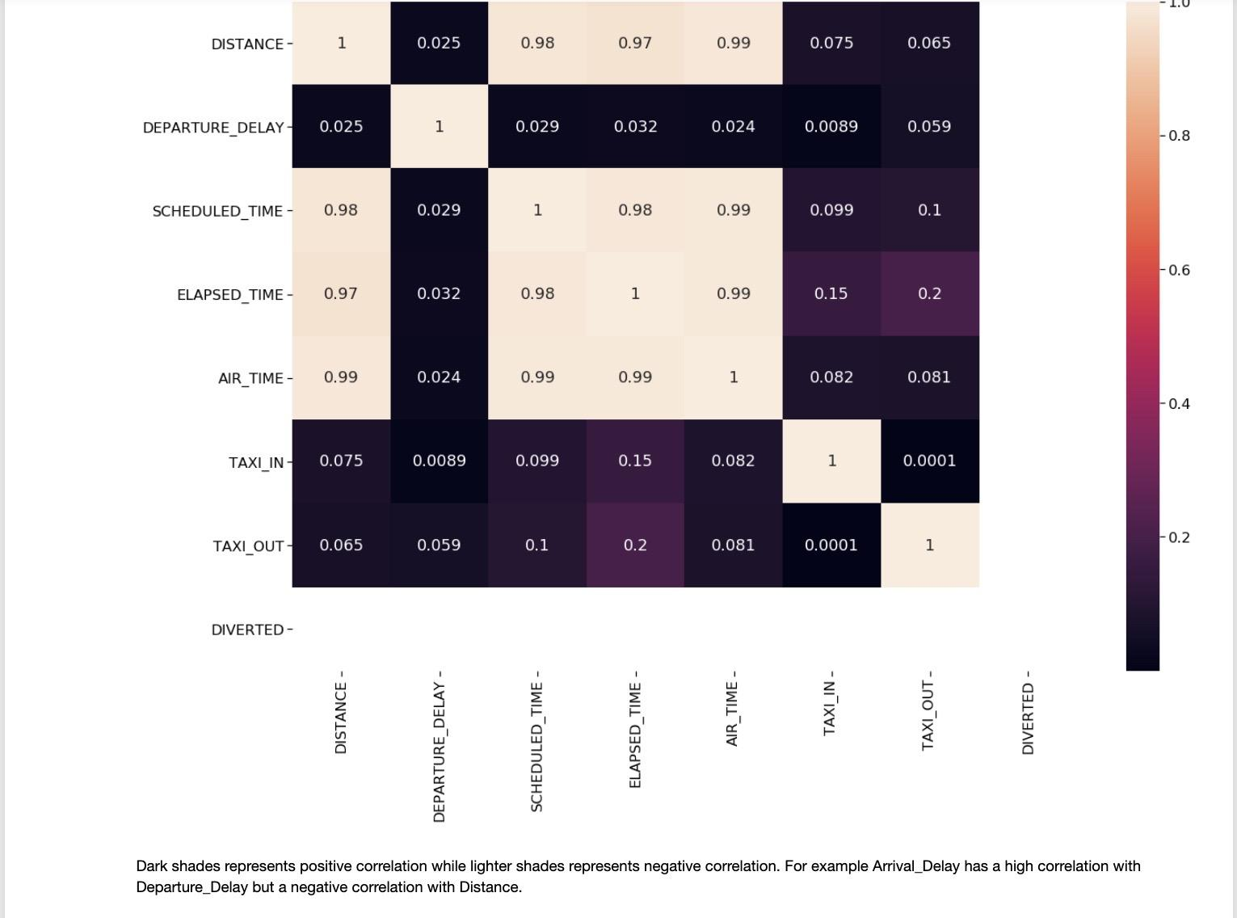
Correlation
Notes:
This the correlation matrix of the numerical variables. As you can see that the scheduled time is highly correlated/dependent with distance, elapsed time and air time. Because it is obvious that longer the distance, higher the airtime. The dark cells shows less dependency between features.

Slide 20
Dataset
5
.
For simplicity, in this project a random sample of the data (n=100000 is used for modeling.

Slide 21
Model Prediction
To predict how long a flight will be delayed at the Destination airport. I randomly split the complete data into training and test sets. 80:20 so that the prediction can be done on the testing Data.
The technical aspect used for modeling includes sklearn: Linear regression, Random Forest and Decision Tree.

Slide 22
Cross Validation
To determine the optimal values and accuracy of the model, I used Grid Search and cross-validation. I Create a cross-validation sets from the training data
cv_sets = ShuffleSplit(test_size = 0.20, random_state = 0)
# Create a decision tree regressor object
regressor = RandomForestRegressor()
# Create a dictionary for the parameter 'max_depth' with a range from 1 to 10
params = {'max_depth': range(1, 12, 3),'n_estimators': range(1, 15, 5)}
# Transform 'performance_metric' into a scoring function using 'make_scorer'
scoring_fnc = make_scorer(performance_metric)
# Create the grid search object
grid = GridSearchCV(regressor, params, scoring_fnc, cv=cv_sets, verbose= 0)# which model will be optimal, plot performance and see how it
Notes:
The parameters we optimized are max_depth(tree depth of random forest) and n_estimators (number of trees in the forest). Then we ran the grid search to find the optimal number of parameters. We also used max_features using three methods. [sqrt, log2 and none]

Slide 23
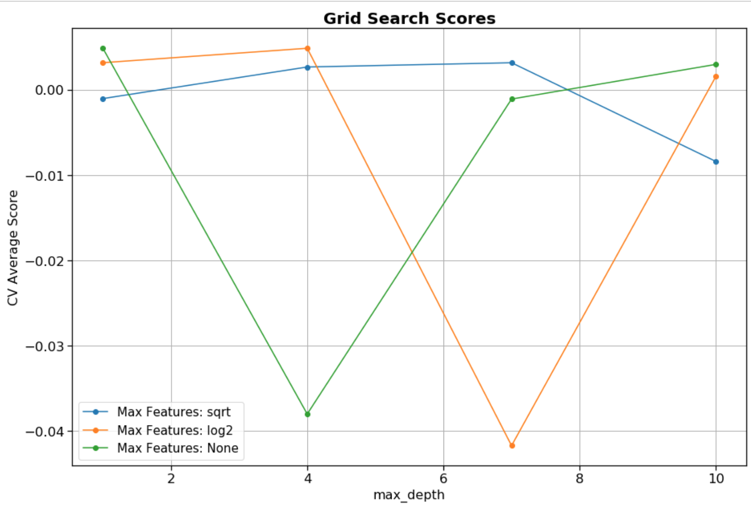
Notes:
For max_features method sqrt, the depth of 7 was the best.
For max_features method log2, the depth of 4 was the best.
For max_features method none, the depth of 10 was the best.

Slide 24
Model Fitting & Results
Name | R2 | Root Mean Square Error
Linear Regression | 0.028 | 35.74
Random forest Regressor | -0.085 | 37.76
Decision Tree Regressor | -0.82 | 48.88

Slide 25
Advantage/Disavantage
Advantage & Disadvantage of using Linear Regression, Decision Tree and Random Forest
Advantage: Linear Regression is that it helps to find the relationships between independent and dependent variables.
Disadvantage: Linear regression only looks at linear relationships between dependent and independent variables.
Advantage decision tree can handle both numerical and categorical data. And it is extremely fast to run.
Disadvantage The model is prone to overfitting, especially when a tree is particularly deep.
Advantages: 1.Random Forest has the ability to handle multiple input features without the need for features deletion.
Random Forest Works well with missing data. Ant it still gives better predictive accuracy.
Disadvantage: Random Forest is Not easily interpretable

Slide 26
Conclusion
I use 100000 samples to predict how much a flight will delay. Before applying machine learning, I performed One-hot coding to convert the categorical values into numerical values. For the prediction, I separated the dataset into training and testing. Training data helps recognize patterns in the dataset. And Testing data is used to evaluate the performance of the model.
Also, From sci-kit-learn, I used Linear regression, Random forest, and Decision Tree for model comparison. I also used scaling, a method used to normalize the range of independent variables or features of data. To determine the optimal values and accuracy of the model, I used Grid Search and cross-validation to get the best model.
DISCUSSION
The models did not work. I only compared three models: Linear Regression, Random Forest, and Decision Tree. For future reference, I would use more models to make my comparison. I can also try some deep learning techniques.
Other model i can use to make the prediction?
We can use a classifier to predict whether a flight will be significantly delayed or not by converting the data in to classes of major delays(where the delays is significant) and minor delays.
One more thing we can try is to use a more complex model like neural network which can capture the complicated patterns of the data and can produce some good results.
Notes:
Grid search was performed on random forest with trying different features and different depths of the trees. That’s how we performed cross validation.

Slide 27
THANK YOU
22

Slide 28
Feedback
Congratulations on completing your capstone! Your introduction is well written and clearly identifies the problem at hand and how your model will solve the problem. Great job walking the reader through the data cleaning you did with null values and merging the three data sets. The visualizations of outliers is nice, but I'm not sure where you actually removed outliers, or if you did anything with them. With the regards to the exploratory data analyses, you may want to do more investigations around the questions you are trying to answer. For example, which airlines have the most delays? Are there certain locations with more delays than others? Are there relationships between weather conditions and delays? Try thinking about exploratory data analyses as a way to figure out what's causing these delays. Your modelling work is well done. I suggest putting the pros and cons of the models into a table to make them easier to read. Walk the reader through the hyper parameter tuning you did. What does it mean? How does it impact the model? Lastly, your conclusion states the model didn't work. What are things you could try? Could you split the data into "major delays" and "minor delays" and build a classifier? Classifiers are typically easier to model.
Congratulations and keep up the great work

